Slide 1
Streams & Rivers | Lakes & Ponds | Groundwater | Monitoring
m/s describe this measurement | Upper layer in a lake | Water below the surface of the ground | N
Need V and A to determine this | My footprints made the lakes | Measures head in the groundwater at a point | Quick sampling method for habitat condition in a river
Area on inside of bend in river. | NTUs | Storage of water underground | PO₄
I am the SI unit of discharge | Lake status if nutrient poor | This happens around the well when pumping | A five day oxygen test for productivity
Filamentous algae growing on the rocks | A curved lake in a floodplain | Top of saturated water in the ground | Runs real time and continuous monitoring stations in CT rivers
1, 2, 3, 4, 5 is used for? | I am a microscopic animal in a lake | A well that flows above the ground surface | Best way to sample sediment in a river
Sediment moving along bottom of stream | A lake made from a melting ice block | Transport due to flow of water | TSS
‘n’ in Manning’s equation | Windblown setup in lake | Rate of spread due to concentration gradient | NH₃ NO₃
Cobble surrounded by 25% fine materials. | I am used to sample algae. |  | A rule established by an authority (e.g. 10 mg/L NO₃)
EPT index | Aging of lake | Controls the direction of groundwater flow | LC₅₀
100
100
100
100
200
200
200
200
300
300
300
300
400
400
400
400
500
500
500
500
600
600
600
600
700
700
700
700
800
800
800
800
900
900
900
900
1000
1000
1000
1000

Slide 2
m/s describes this measurement
Answer

Slide 3
What is Velocity

Slide 4
This is the upper layer of a lake
Answer

Slide 5
What is the Epilimnion

Slide 6
The surface of water found belowground
Answer

Slide 7
What is the Water Table

Slide 8
The chemical element with the symbol N
Answer

Slide 9
What is Nitrogen

Slide 10
You need area and velocity to determine this
Answer

Slide 11
What is Discharge

Slide 12
These temporary wetlands are important spring habitat
Answer

Slide 13
What are Vernal/Ephemeral Pools

Slide 14
This controls the direction of water flow
Answer

Slide 15
What is Head

Slide 16
A quick method for assessing river habitat conditions
Answer

Slide 17
What is a Rapid Bioassessment

Slide 18
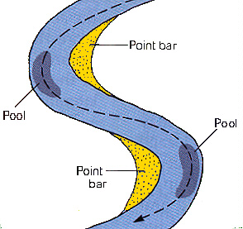
The yellow area below
Answer

Slide 19
What is a Point Bar

Slide 20
NTUs are a unit of this
Answer

Slide 21
What is Turbidity

Slide 22
In coastal areas, excessive ground water pumping may cause fresh ground water to mix with this, causing contamination
Answer

Slide 23
What is salt water

Slide 24
PO₄
Answer

Slide 25
What is Phosphate

Slide 26
The unit for discharge
Answer

Slide 27
What is m³/s

Slide 28
Status of a nutrient-poor lake
Answer

Slide 29
What is Oligotrophic

Slide 30
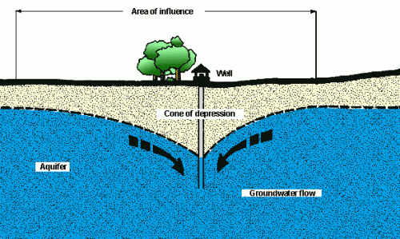
This happens around the well when pumping
Answer

Slide 31
What is Drawdown/Cone of depression

Slide 32
BOD is an acronym for this test of lake productivity
Answer

Slide 33
What is Biological Oxygen Demand

Slide 34
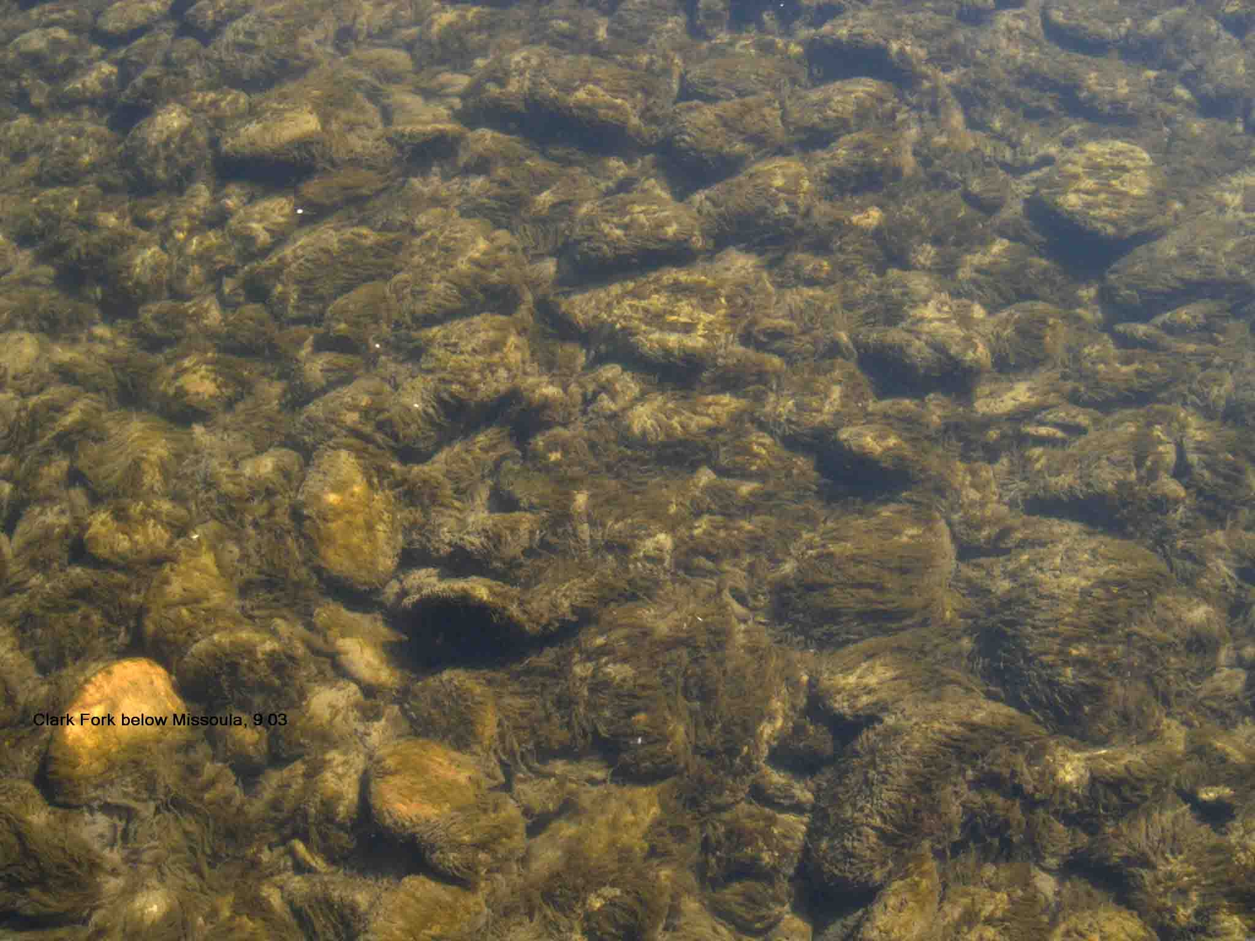
Filamentous algae growing on rocks
Answer

Slide 35
What is Periphyton

Slide 36
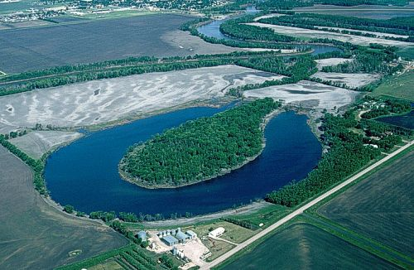
A curved lake in a floodplain
Answer

Slide 37
What is an Oxbow

Slide 38
This is the study of the distribution and movement of ground water in the soil and rocks of the Earth’s crust
Answer

Slide 39
What is hydrogeology

Slide 40
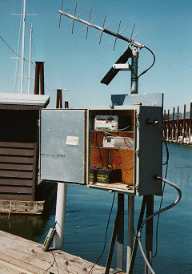
This federal agency operates monitoring stations in CT rivers
Answer

Slide 41
What is the USGS

Slide 42
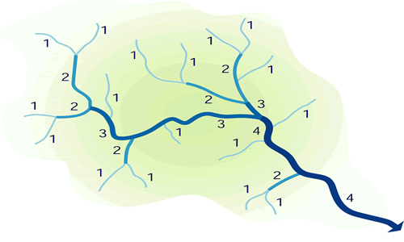
These numbers are used to describe this
Answer

Slide 43
What is Stream Order

Slide 44
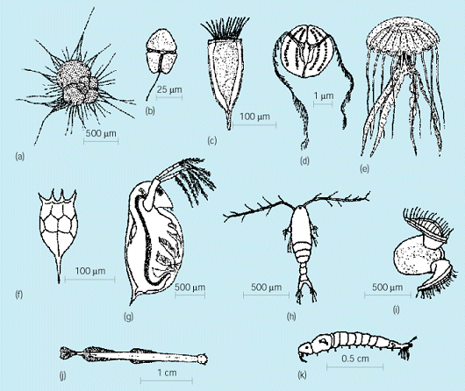
Microscopic lake animals
Answer

Slide 45
What is Zooplankton

Slide 46
Groundwater makes up this % of the world’s fresh water
Answer

Slide 47
What is 30%

Slide 48
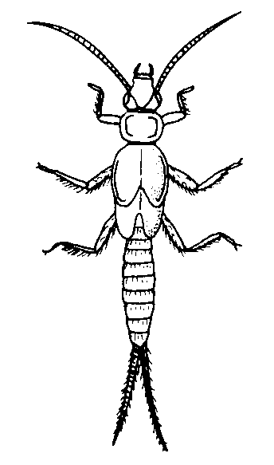
The presence of this larvae indicates a healthy stream
Answer

Slide 49
What is Stonefly

Slide 50
Besides biological and chemical, this is the third characteristic of water quality
Answer

Slide 51
What is Physical

Slide 52
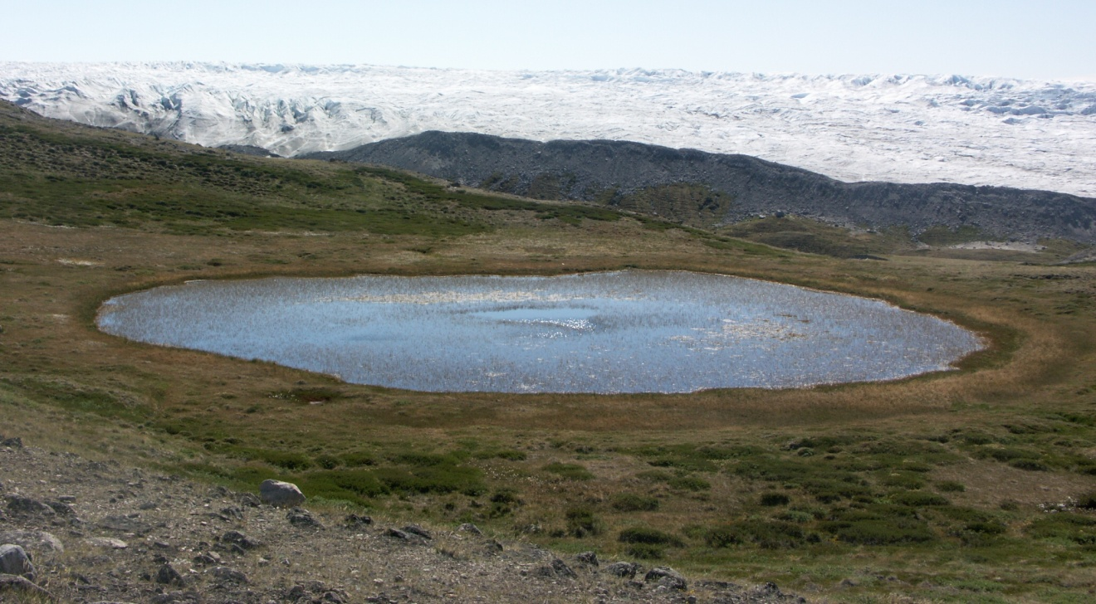
A lake made from ice blocks left behind from glaciers
Answer

Slide 53
What is a Kettle

Slide 54
This type of aquifer has layers of impermeable material both above and below it.
Answer

Slide 55
What is a confined aquifer

Slide 56
The water quality parameter TSS stands for this
Answer

Slide 57
What are Total Suspended Solids

Slide 58
The Missouri river is the longest in the US, but this river has the most discharge at 18,000 m³/s
Answer

Slide 59
What is the Mississippi

Slide 60
This is the study of lakes and ponds
Answer

Slide 61
What is Limnology

Slide 62
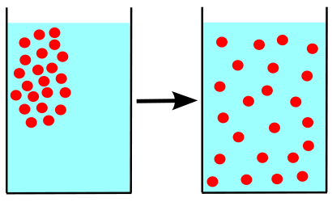
The rate of spread due to a concentration gradient
Answer

Slide 63
What is Diffusion/Dispersion

Slide 64
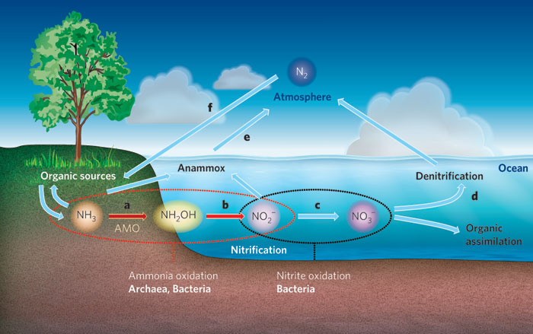
The oxidation of ammonia to nitrate
Answer

Slide 65
What is Nitrification

Slide 66
This 1972 federal law regulates point source discharges to the nations waters
Answer

Slide 67
The Clean Water Act

Slide 68
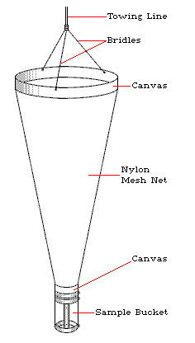
This tool is used to sample algae
Answer

Slide 69
What is a Plankton Net

Slide 70
The % of rainfall in the US that goes into groundwater
Answer

Slide 71
What is 25%

Slide 72
This is the largest source of non-point pollution in the U.S.
Answer

Slide 73
What is agriculture

Slide 74
EPT index stands for this
Answer

Slide 75
What is Ephermeroptera, Plecoptera, Tricoptera

Slide 76
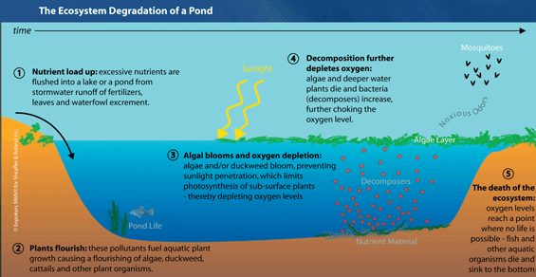
This process
Answer

Slide 77
What is Eutrophication

Slide 78
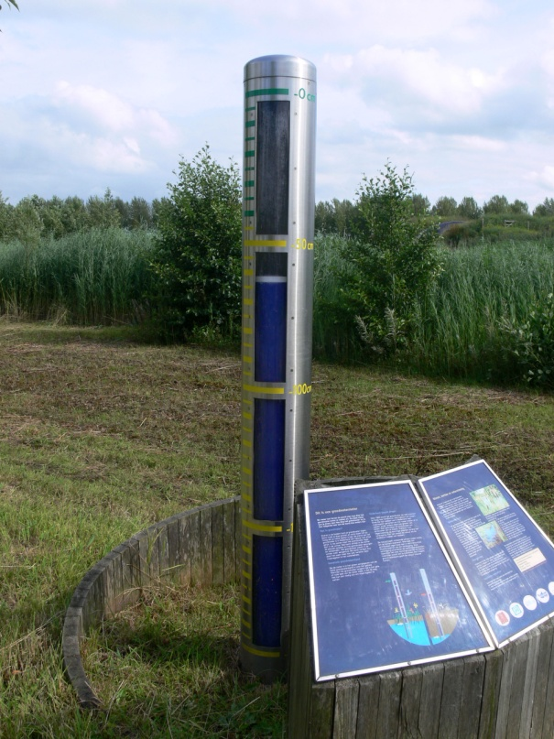
This is used to measure groundwater head
Answer

Slide 79
What is a Piezometer

Slide 80
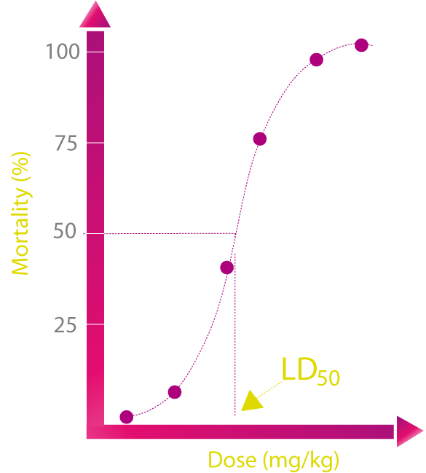
LC₅₀
Answer

Slide 81
What is the Lethal Concentration for 50% of organisms

