Slide 1
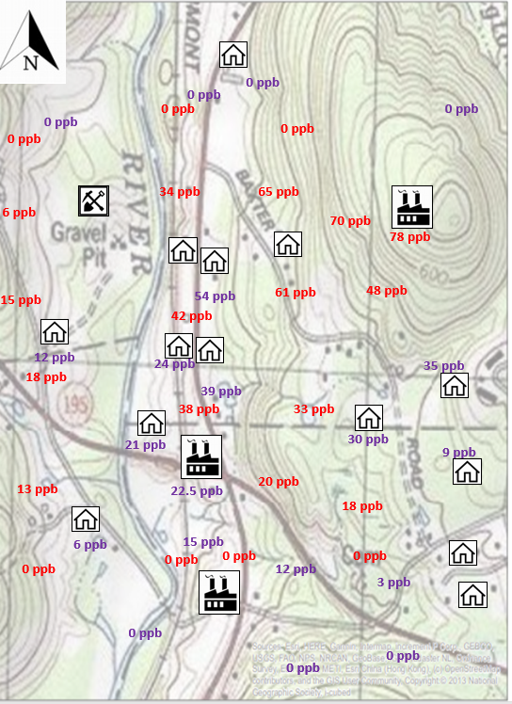
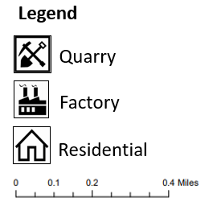
Purple values = Data from drinking water wells
Red values = Data from drilled groundwater wells
Last week, you were provided data to show how contamination sources can vary within a town. Here is a similar town with a similar contamination problem, but this time, you are provided a topographic map.
Show how the contamination plume moves as elevation changes.
What might be the cause of the contaminant levels on the west side of the river? Could there be multiple sources?
What feature seen on this map could restrict the plume movement?
What do you think happens to the contaminated groundwater when it reaches the river?
Explore the link to find out: https://pubs.usgs.gov/circ/circ1139/htdocs/boxm.htm

Slide 2
3
0 ppb
0 ppb
0 ppb
0 ppb
0 ppb
0 ppb
0 ppb
36B
34 ppb
65 ppb
6 ppb
70 ppb
78 ppb
Purple values = Data from drinking water wells
Red values = Data from drilled groundwater wells
42 ppb
54 ppb
61 ppb
48 ppb
15 ppb
Here is the same town as shown on the topographic map, but instead, shown on a soil map.
Which soil type(s) do you think allows a contamination plume to migrate the most? Why?
Which soil type(s) do you think allows a contamination plume to migrate the least?
The table on the next slide contains information that could be extracted from Web Soil Survey that allows you to understand some useful characteristics for each soil type.
12 ppb
24 ppb
35 ppb
18 ppb
39 ppb
38 ppb
33 ppb
21 ppb
30 ppb
9 ppb
22.5 ppb
20 ppb
13 ppb
18 ppb
15 ppb
0 ppb
6 ppb
0 ppb
0 ppb
0 ppb
12 ppb
3 ppb
0 ppb
0 ppb
0 ppb
97

Slide 3
Map Symbol | Map Unit | Map Unit Description
97 | Pawcatuck mucky peat | The Pawcatuck series consists of very deep, very poorly drained soils formed in herbabceous organic deposits over sandy mineral material. They are in tidal marches subject to inundation by salt water twice daily. Slope ranges from 0 to 1 percent. Saturated hydraulic conductivity is moderately high to very high in the organic layers and very high in the underlying mineral sediments. Mean annual temperature is about 10 degrees C and mean annual precipitation is about 1143 mm.
36B | Windsor loamy sand, 3 to 8 percent slopes | The Windsor series consists of very deep, excessively drained soils formed in sandy outwash or eolian deposits. They are nearly level through very steep soils on glaciofluvial landforms. Slope ranges from 0 through 60 percent. Saturated hydraulic conductivity is high or very high. Mean annual temperature is about 10 degrees C and mean annual precipitation is about 1092 mm.
3 | Ridgebury, Leicester, and Whitman soils, extremely stony | The Ridgebury series consists of very deep, somewhat poorly and poorly drained soils formed in lodgment till derived mainly from granite, gneiss and/or schist. They are commonly shallow to a densic contact. They are nearly level to gently sloping soils in depressions in uplands. They also occur in drainageways in uplands, in toeslope positions of hills, drumlins, and ground moraines, and in till plains. Slope ranges from 0 to 15 percent. Saturated hydraulic conductivity is moderately high or high in the solum and very low to moderately low in the substratum. Mean annual temperature is about 9 degrees C. and the mean annual precipitation is about 1143 mm
Sources:
http://www.cteco.uconn.edu/guides/Soils_Map_Units.htm
https://soilseries.sc.egov.usda.gov/

