Slide 1
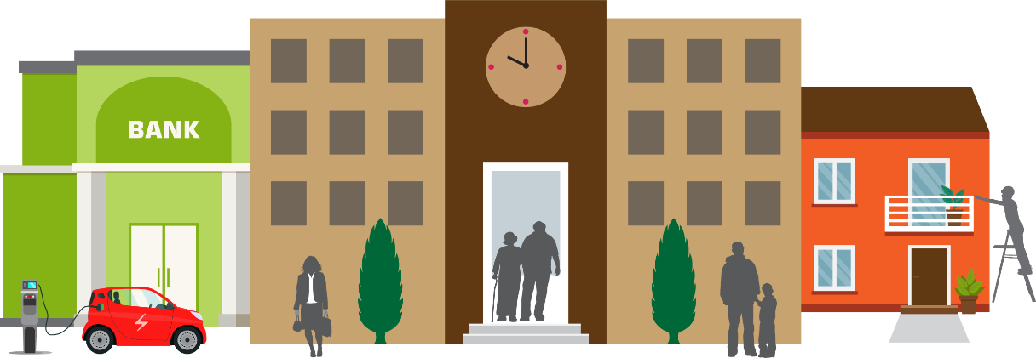
Two Rivers Magnet School
January 2024

Slide 2
Introductions
Bill Colonis
Senior Project Manager
Homeowner Outreach
Bill.Colonis@ctgreenbank.com
I’ve been at the Green Bank for a long time,….
Worked on renewable energy projects for: energy efficiency (EE), solar PV, solar hot water, ground source heat pumps and more!
Yes, I have done measures at my own home incl; EE!, solar hot water
Notes:
Go around and introduce ourselves

Slide 3
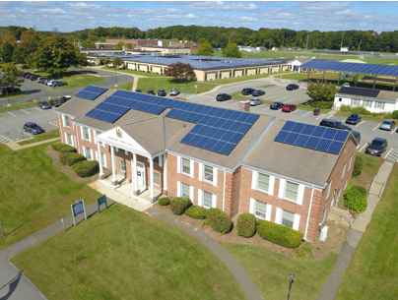
Agenda
Who is the Connecticut Green Bank?
What do we offer?
Energy Efficiency, Smart-E Loan, Solar & Energy Storage

Slide 4
Our mission is to confront climate change by increasing and accelerating investment into Connecticut’s green economy to create more resilient, healthier, and equitable communities
Connecticut Green Bank is the nation’s first green bank. Established in 2011 as a quasi-public agency, the Green Bank uses limited public dollars to attract private capital investment and offers green solutions that help people, businesses and all of Connecticut thrive.
Guiding this mission is our vision for
“…a planet protected by the love of humanity.”
Notes:
A quick introduction of the Connecticut Green Bank.
Created in 2011 through bipartisan legislation, we are a quasi-public agency and the first state-level green bank in the country.
Our mission is to confront climate change by increasing and accelerating investment into Connecticut’s green economy to create more resilient, healthier, and equitable communities.
Guiding this mission is our vision of a planet protected by the love of humanity.

Slide 5
Connecticut Green Bank About Us
Quasi-public organization – Nation’s first green bank (July 2011)
Focus – Finance clean energy (e.g., renewable energy, energy efficiency, and alternative fuel vehicles and infrastructure) by leveraging public capital with multiples of private capital
Support – from a variety of sources, including:
State Support – $0.001/kWh surcharge (i.e., Clean Energy Fund) on electric ratepayer bills (about $7-$10 per household per year ≈ $26 MM per year) and RGGI allowance proceeds about $3-5 MM per year (renewable energy)
5
Notes:
Many of you listening today from Connecticut, know who we are – we are the nation’s first “green bank”.
The Connecticut Green Bank was created by a bipartisan act of legislation in July of 2011.
We focus on providing families and businesses with the capital they need to finance clean energy improvements to their homes and buildings.
We are supported by a system benefit fund from ratepayers of Eversource Energy and United Illuminating through a Clean Energy Fund surcharge that amounts to between $7 to $10 per household per year.
We are supported by regional cap-and-trade allowance proceeds through the Regional Greenhouse Gas Initiative, or RGGI.
Those are our “state support” resources.
We also receive funds from the federal government through competition within various agencies like the DOE or USDA, or through formula allocation in the case of the American Recovery and Reinvestment Act.
We are also advocates of a National Climate Bank Act that takes the Connecticut Green Bank model to the rest of the country.
And now, we are increasingly going to be supported by the people – families of Connecticut and citizens of our country, through the steady and ongoing issuance of Green Liberty Bonds.

Slide 6
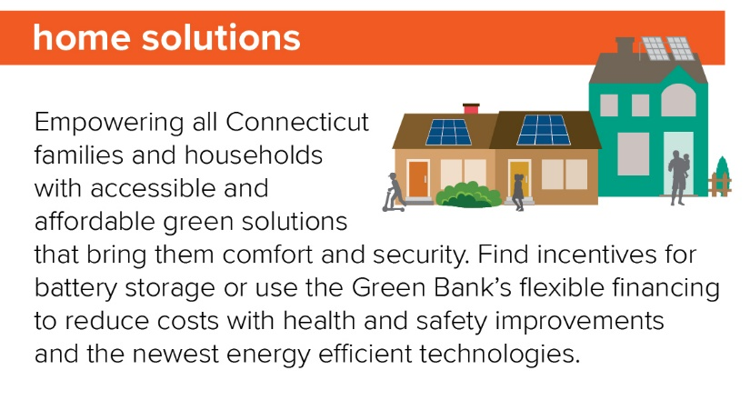
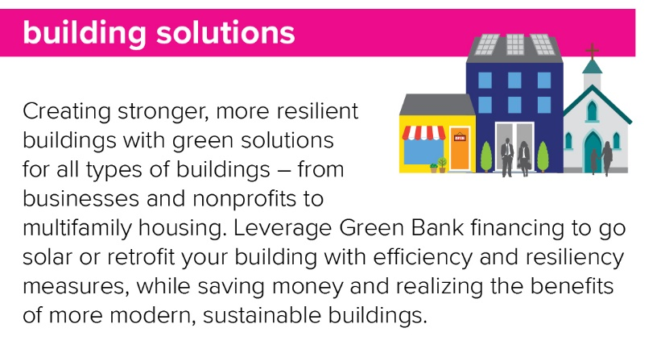
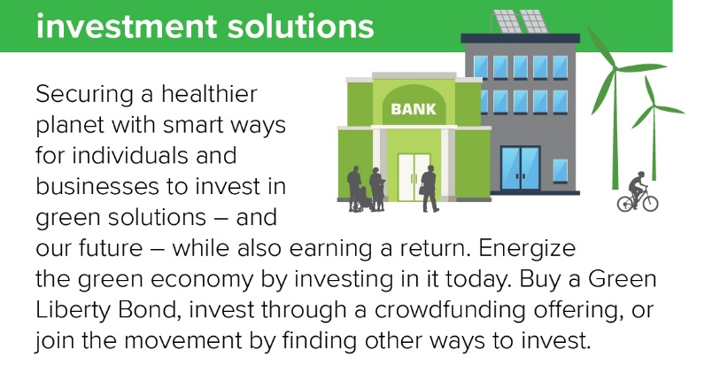
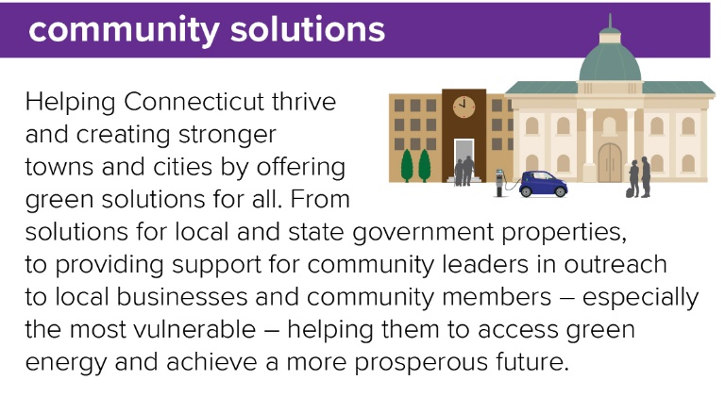
our solutions
our goals
Leverage limited public resources to scale-up and mobilize private capital investment in the green economy of Connecticut.
Strengthen Connecticut’s communities, especially vulnerable communities, by making the benefits of the green economy inclusive and accessible to all individuals, families, and businesses.
Pursue investment strategies that advance market transformation in green investing while supporting the organization’s financial sustainability goals.
Notes:
The important thing is what can be done with these funds. Since our inception, we have helped mobilize more than $2 billion of investment into the State’s green economy. To do this, we leverage a small amount of public dollars to attract multiples of private investment at a 7 to 1 ratio. This means for every public dollar, we bring $7 private dollars into our solutions for homes, buildings, communities, and investments.
Through these solutions lines, we have been able to help reduce the energy burden on more than 65,000 families and businesses across the state. We’ve also helped support the creation of more than 26,000 direct, indirect, and induced job-years, while deploying renewable energy and energy efficiency measures that support environmental and equity goals.

Slide 7
Energy Solutions for Homeowners

Slide 8
Weatherization
The process of making your home better protected against the effects of changing weather.
Elements include:
Air sealing: Reduces drafts and keeps conditioned air in to maintain a comfortable temperature in your home for longer
Duct sealing: Makes sure conditioned air gets to intended locations
Insulation: A protective layer between your living space and the element
Windows: Work like insulation to help keep conditioned air in and outside air out

Slide 9
Why Weatherize?
Optimize your HVAC system’s performance
Makes your home comfortable
Helps maintains the temperature in your home for longer
Results in a cleaner home
Helps the environment
Reduces your energy bills, saving you money

Slide 10
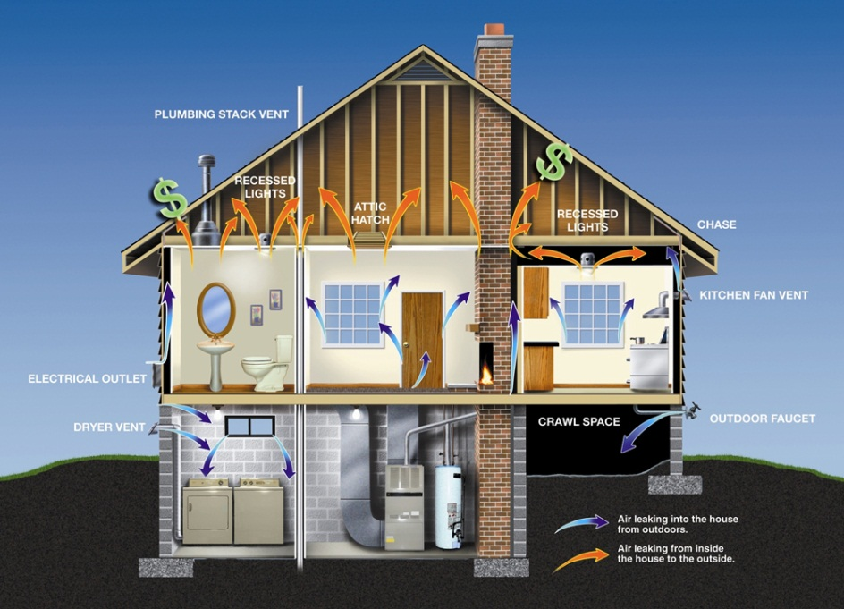
Home Energy Solutions
Assessment and service that treats the home as a system to:
Increase efficiency
Optimize comfort
Currently $50 copay to all qualifying homeowner & rental customers

Slide 11
Home Energy Solutions
Receive services and no-cost products valued at $1,000
Receive access to special rebates available only to program participants
Participants save an average of $200 a year on energy bills
You may be eligible for a rebate for costs of eligible projects (incl. insulation & heat pumps)
Schedule a Home Energy Solutions visit
1-877-WISE-USE (947-3873)
EnergizeCT.com

Slide 12
Services & Benefits
Blower door-guided air sealing
Duct sealing
Reduced costs on your energy bills
Less pollen, dust and insects entering your home
Home Energy Report & Home Energy Score
Water-saving measures
Reduced noise from outside
Better humidity control, minimizing mold and mildew
Health and safety tests on heating equipment (e.g., oil boiler, gas furnace)
Lower chance for ice dams on your home’s roof/eves
Energy-saving lighting
A less drafty, more comfortable home year-round

Slide 13
Smart-E Loan

Slide 14
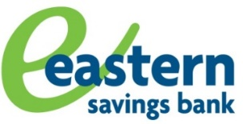
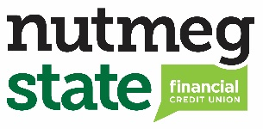
Financing for Projects Smart-E Loans
Terms | 5 or 7 Years | 10 Years | 12 Years | 15 or 20* Years
Rates | 5.99% | 6.99% | 7.49% | 7.49%
Unsecured, personal loan for energy improvements at 1-4 unit, owner-occupied residential properties statewide in Connecticut
40+ eligible measures
HVAC, solar, insulation, windows, etc.
Loan amounts: $500 - $50,000
No money down
Fixed monthly payments
No prepayment penalty
* Lender participation varies
www.ctgreenbank.com/smarte
Notes:
Borrower qualifications:
580+ FICO score
50% debt-to-income (“DTI”) maximum
DTI screen waived for 680+ FICO
No review of utility bill history

Slide 15
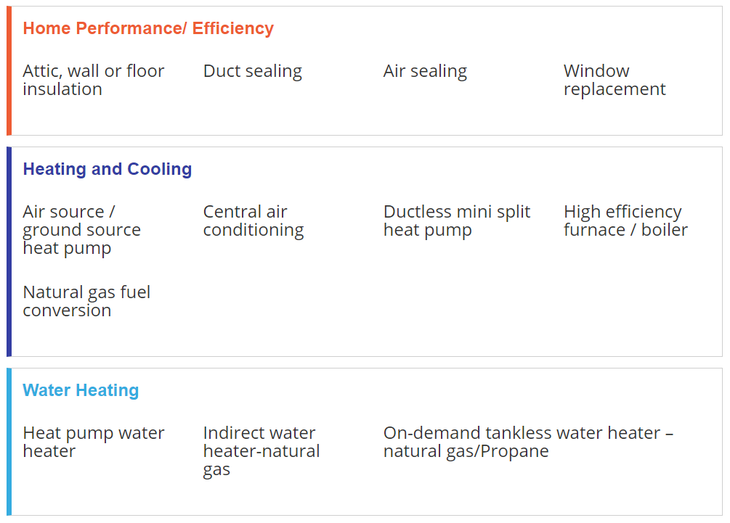
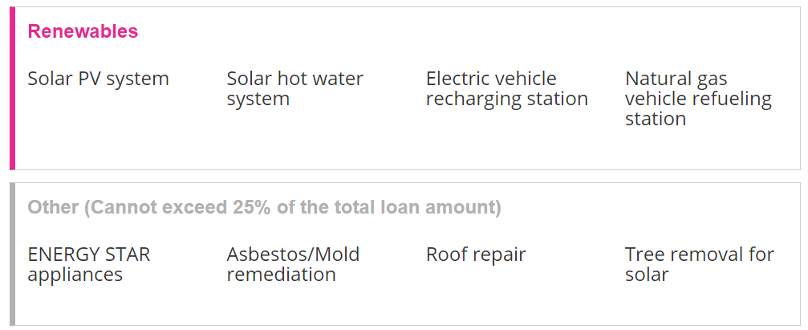
Financing for Projects (examples)

Slide 16
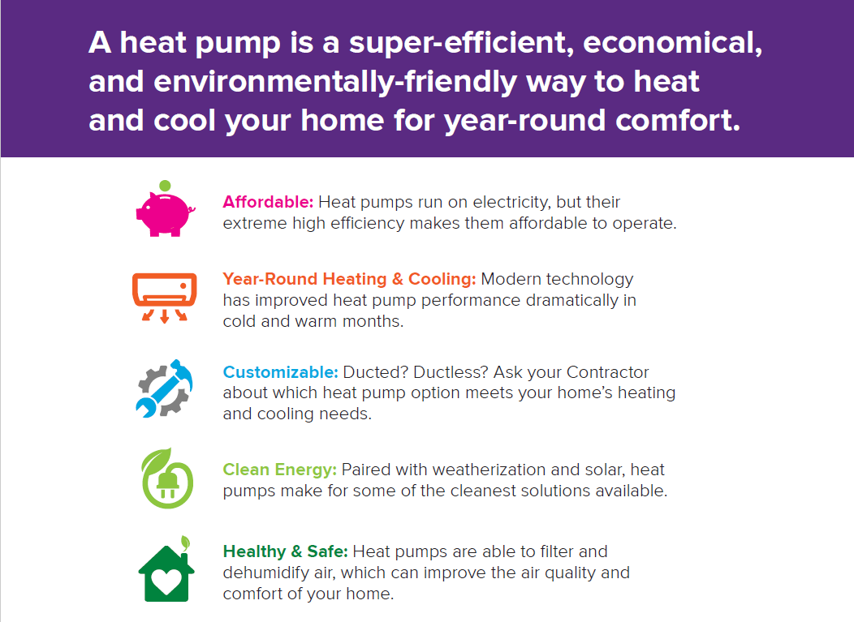
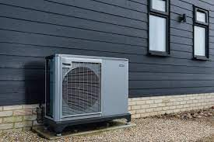
Ductless mini splits
Air source heat pumps
Heat pump hot water heaters
Geothermal/ground source heat pumps

Slide 17
Geothermal and Solar

Slide 18
Geothermal
Closed Loop
Open Loop
Horizontal
[30]
Vertical
[31]
[33]
Pond/ Lake
[32]
Notes:
Geothermal Heat pumps use heat from the constant high temperature below the earth’s surface to supply heat to a property or can even help cool a building down during the hot, summer climate.
4 types of Geothermal Systems:
Horizontal, Vertical and Pond/ Lake that are all part of the closed loop category
Open loop
Horizontal Loop:
Vertical:
Pond/ Lake:
CT prefers closed loop over open loop
Closed vs. Open

Slide 19
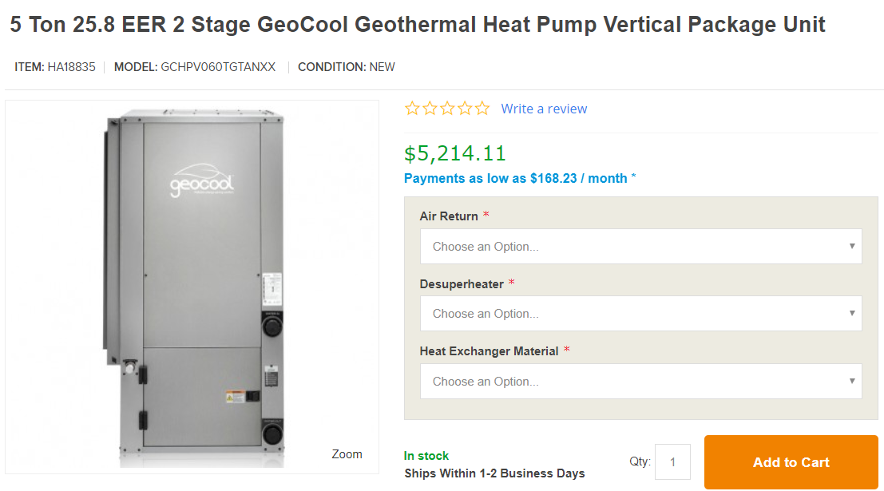
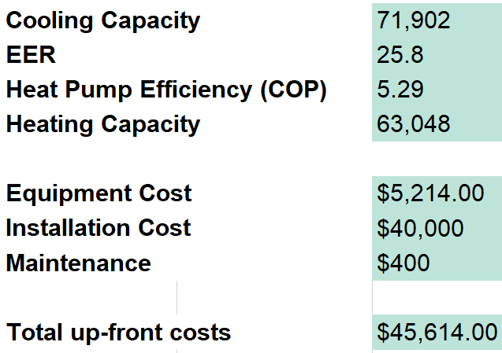
Geothermal Heat Pump Equipment
[9]

Slide 20
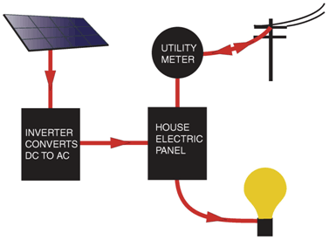
Solar Photovoltaic (PV)
Use sunlight to make electric power
Typical system components:
Solar panels (modules)
Racks, wiring,
Inverter (DC to AC power)
Grid tied system(s):
DO NOT Provide back up power
System Considerations:
Shading, orientation
Annual electric load
Size to meet <100% of load
Listed on CEC website

Slide 21
Siting Solar Systems
A good site for solar:
Sunlight: Full sun from 9 a.m. to 3 p.m.
No shading: even deciduous trees can block 40%-60% of sunlight
Azimuth: Facing due south, ± 30°
Tilt:
For PV – Latitude, adjusted for climate (in CT, 35°)
For solar hot water - 0.9 x Latitude + 30° (for seasonal balance – in CT, 68°)
Notes:
Compared to a fixed mount, a single axis tracker increases annual output by approximately 30%, and a dual axis tracker an additional 6%.

Slide 22
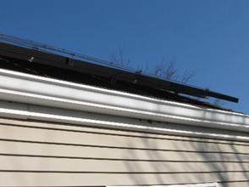
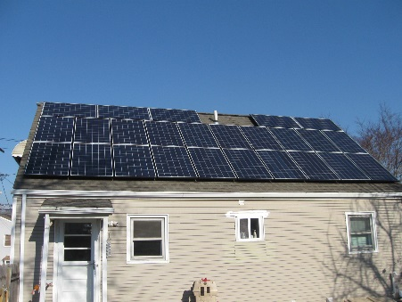
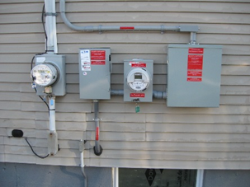
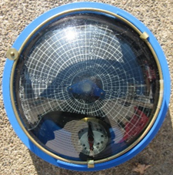
Typical Solar Installation
Crystalline PV Panels
Solar Photovoltaic Panels
16 kw
Shading Analysis
Meter and Disconnects

Slide 23
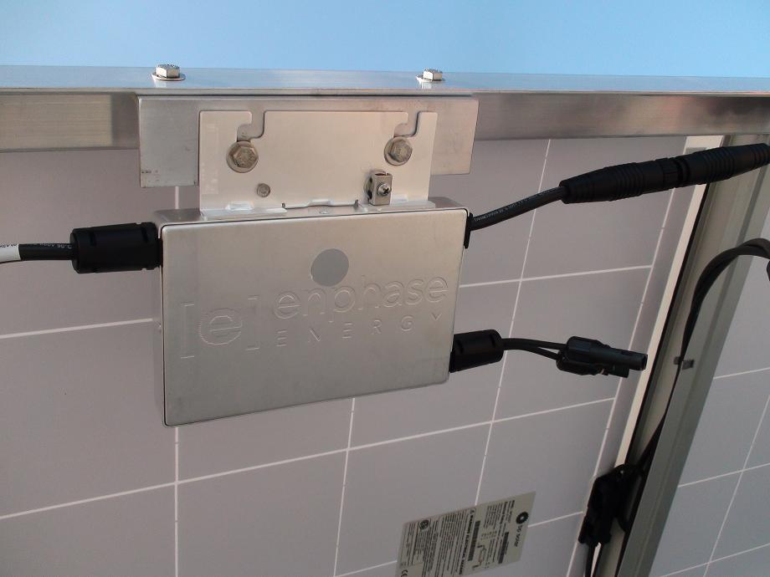
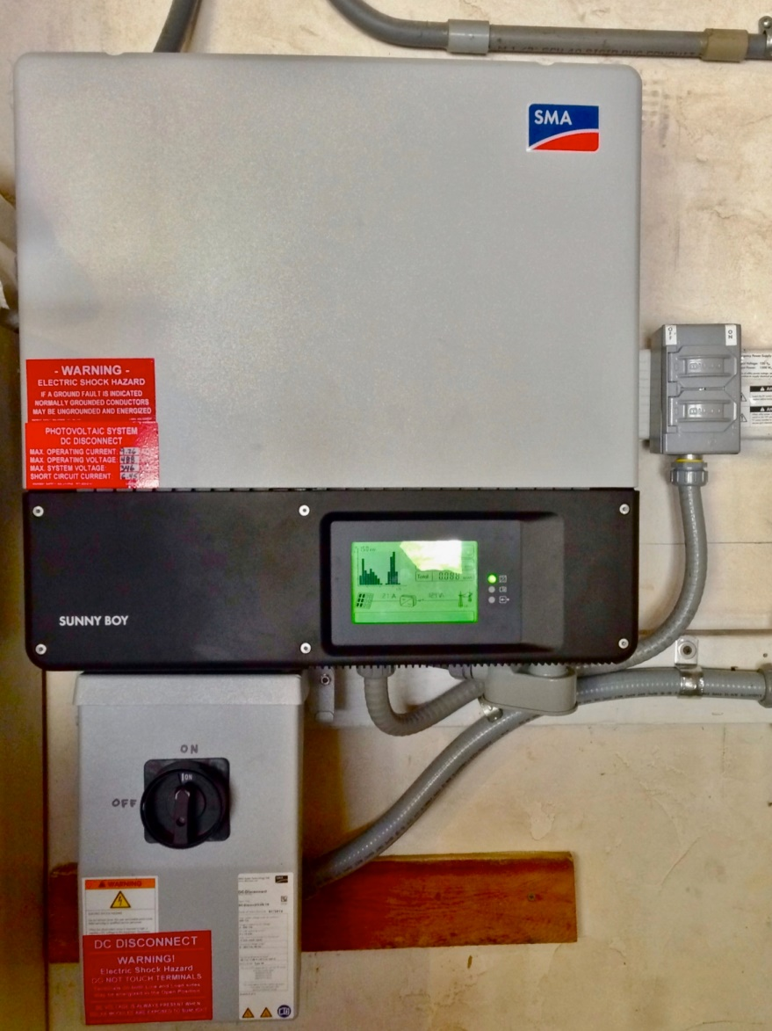
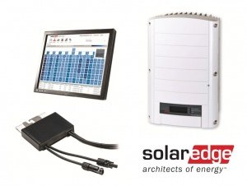
Three types of residential inverters
String Inverter
Micro Inverter
Optimizer type Inverter

Slide 24
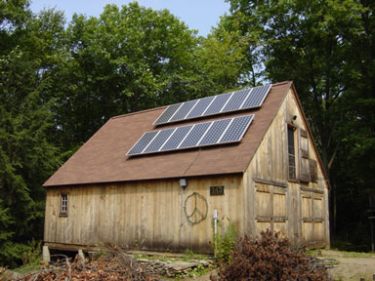
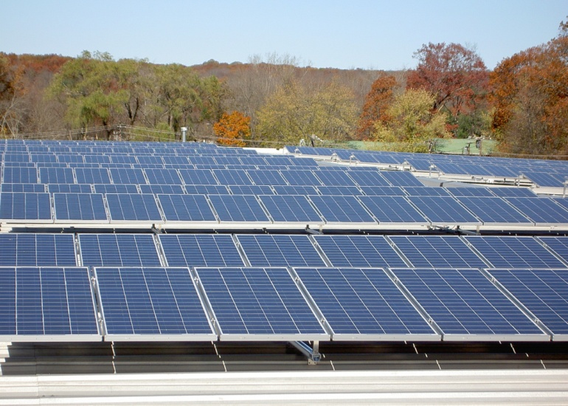
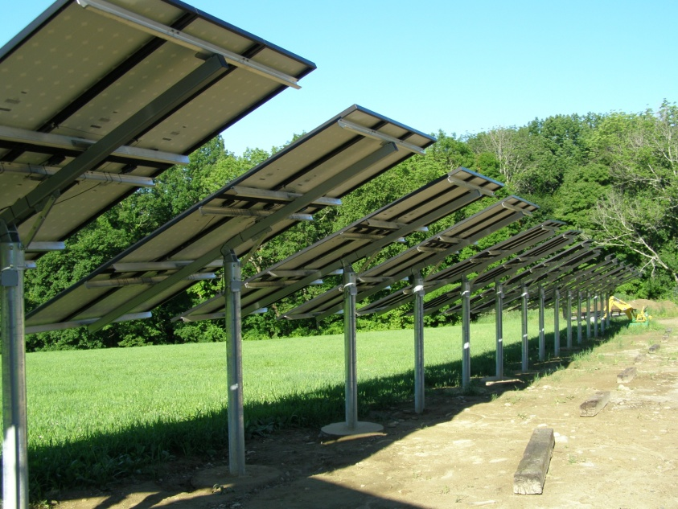
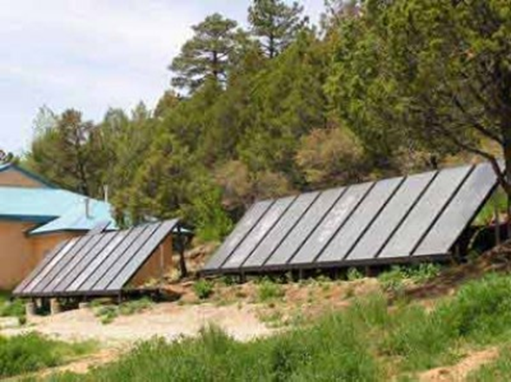
Background - PV
Home –Roof-mount, slanted
Flat Roof – rack-mounted
Pole-mounted (tacking system, seasonal adj.)
Ground - mounted

Slide 25
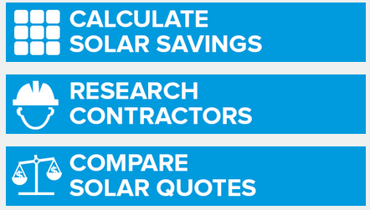
Thinking of Going Solar?
1. Do your research
Technology
Financing
2. Find contractors
3. Compare quotes
Take your time
Do what is best for you
4. Enjoy the benefits of solar!
Notes:
How do you go solar? The best tool you can have is knowledge. Always do your research first. Solar is a new technology for a lot of people. In some ways, it is comparable to other home improvements or large purchases, but in other ways, it is very different. Solar is one of the few home improvements with measurable return on investment (more on that in a few slides)
The technology is always improving, so it’s hard to say there’s “good” time to go solar relative to better technology coming out. However, it’s largely incremental improvements in a proven technology (crystalline silicon modules). Efficiency, power density, and reliability are what improve over time.
Most contractors use the “good” equipment that’s available, but there are “premium” modules (SunPower).
To find a contractor, we suggest starting with the Find a Contractor tool on. You can then narrow it down with searching for reviews online. Once you feel comfortable reaching out, set up a few appointments. As with any large purchase, take your time! Incentives are limited, but don’t feel rushed. Solar doesn’t work for every home.

Slide 26
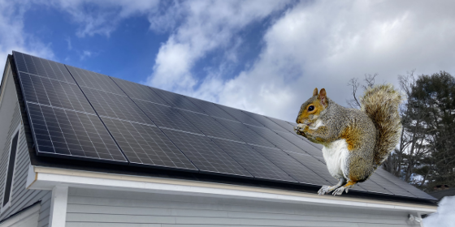
Questions to consider if going solar
What is my roof orientation? Is there a good solar resource?
What are my financing options? – review in next slide
Who is responsible for what repairs (if needed)?
Is the contract clear? What is my expected solar production and how much is the Power Purchase Agreement (PPA ) or lease?
What happens at the end of the lease?
How old is my roof and what condition is it in?
What if I need a new roof during the contract period?
Do I feel comfortable with what is presented to me?
Will my insurance increase? What will they cover?
Does a critter guard make sense?
Notes:
Sara
How do you go solar? The best tool you can have is knowledge. Always do your research first. Solar is a new technology for a lot of people. In some ways, it is comparable to other home improvements or large purchases, but in other ways, it is very different. Solar is one of the few home improvements with measurable return on investment (more on that in a few slides)
The technology is always improving, so it’s hard to say there’s “good” time to go solar relative to better technology coming out. However, it’s largely incremental improvements in a proven technology (crystalline silicon modules). Efficiency, power density, and reliability are what improve over time.
Most contractors use the “good” equipment that’s available (Jinko, Hanwha), but there are “premium” modules (LG, SunPower).
To find a contractor, we suggest starting with the Find a Contractor tool on gosolarCT.com (link). You can then narrow it down with searching for reviews online. Once you feel comfortable reaching out, set up a few appointments. As with any large purchase, take your time! Incentives are limited, but don’t feel rushed. Solar doesn’t work for every home.

Slide 27
Solar Financing
Lease
Can be $0 down
Owned by a third-party
Full warranty
Some offer production guarantees
Fixed monthly rate
20-25 years
Typically escalates 2-3% yearly
Power Purchase Agreement (PPA)
Can be $0 down
Owned by a third-party
Full warranty
Some offer production guarantees
Monthly rate varies seasonally
20-25 years
Typically escalates 2-3% yearly
Loan / Cash
Upfront cash investment
Limited warranty (5-15 years labor)
Some loans offer production guarantees
Payback is typically 7-10 years

Slide 28
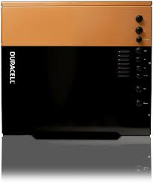
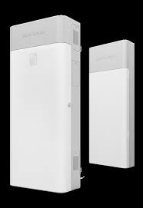
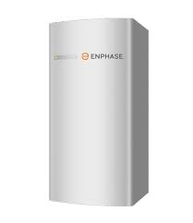
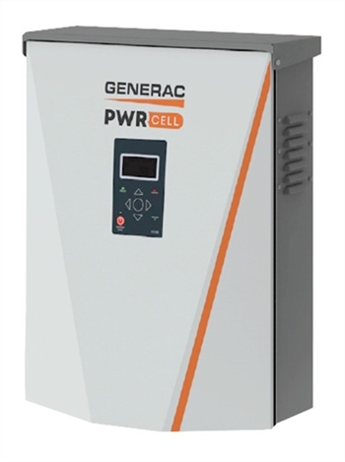
Energy Storage Solutions
energystoragect.com
Notes:
Sara and Ed / questions
Community shared solar
Batteries / energy storage
Infrastructure, municipal or grid energy storage

Slide 29
Questions?
For more resources on HVAC, going solar and other energy efficiency measures, visit www.energizect.com
For information on the Green Bank, visit www.ctgreenbank.com

Slide 30
Thank you!
Notes:
Q&A

